Slide 1
Docker & Kubernetes
Masukkan teks Anda di sini.

Slide 2
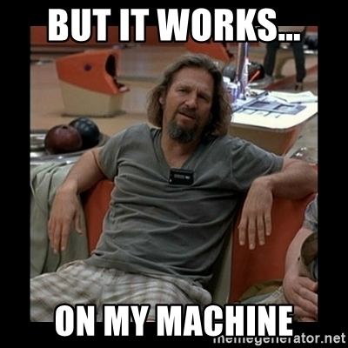

Slide 3
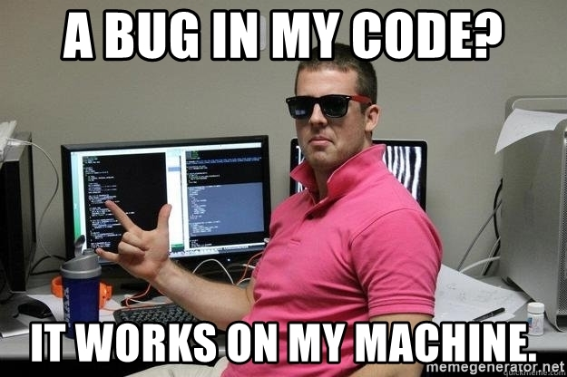

Slide 4
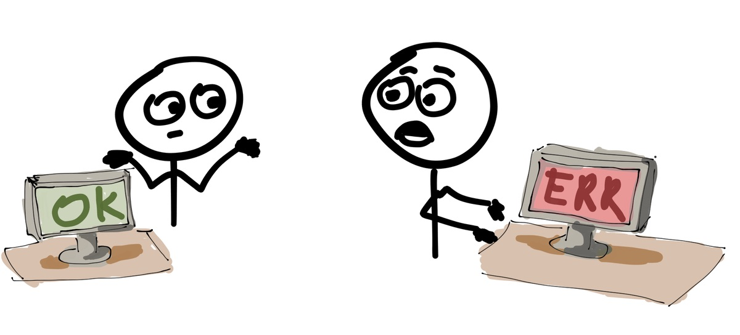

Slide 5
Deploying Application
WEB SERVER
DATABASE
APPLICATION
LIBRARY
RUNTIME APP
OPERATING SYSTEM
SERVER

Slide 6
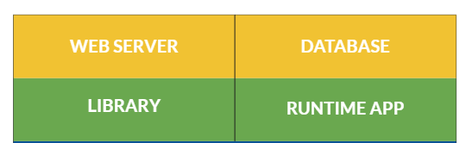

Deploying Application
Application

Slide 7
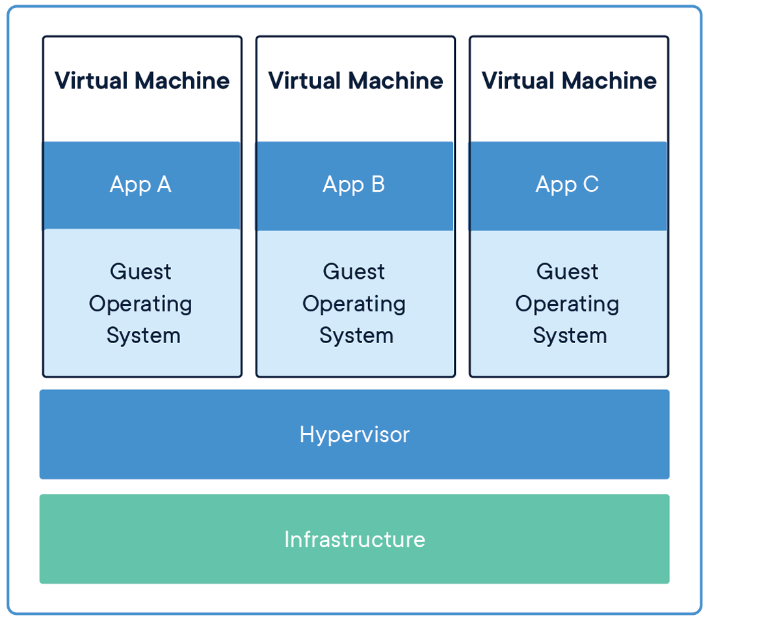
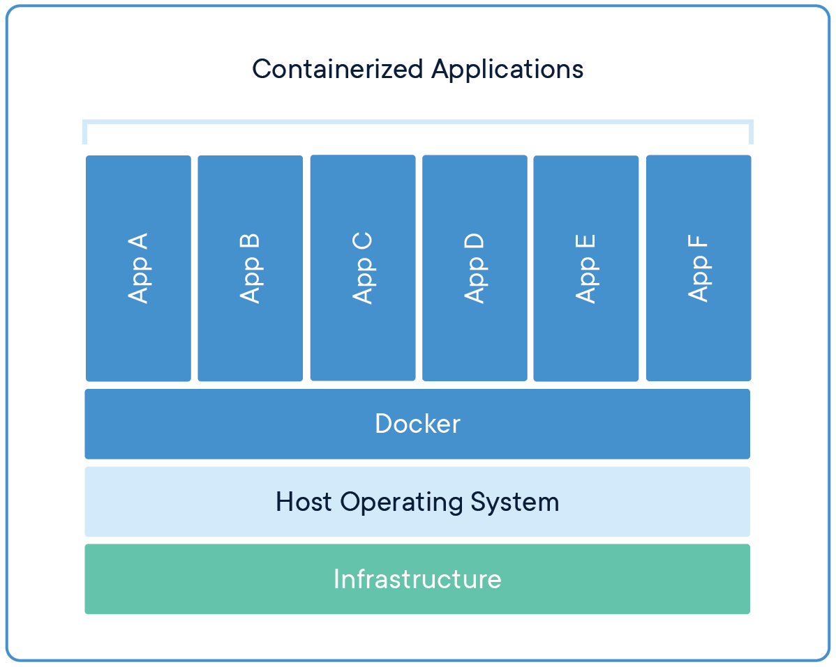
Containers vs Virtual Machines
source: docker.com

Slide 8
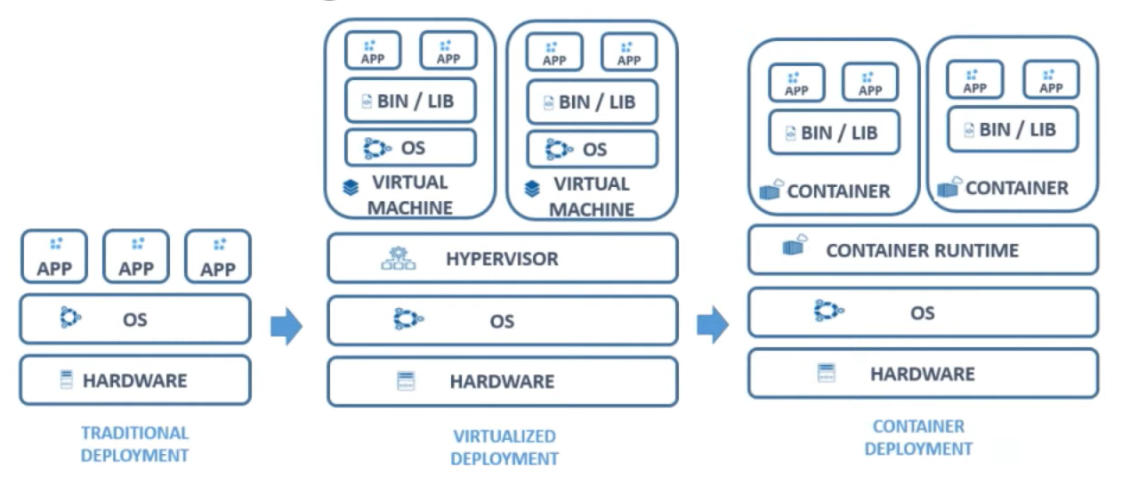

Slide 9
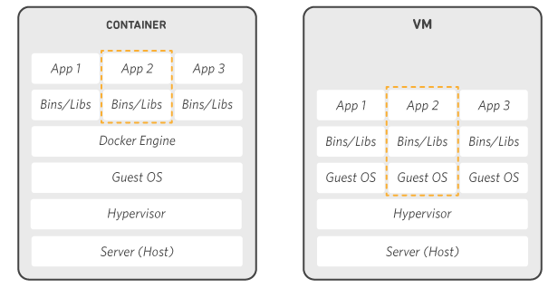

Slide 10
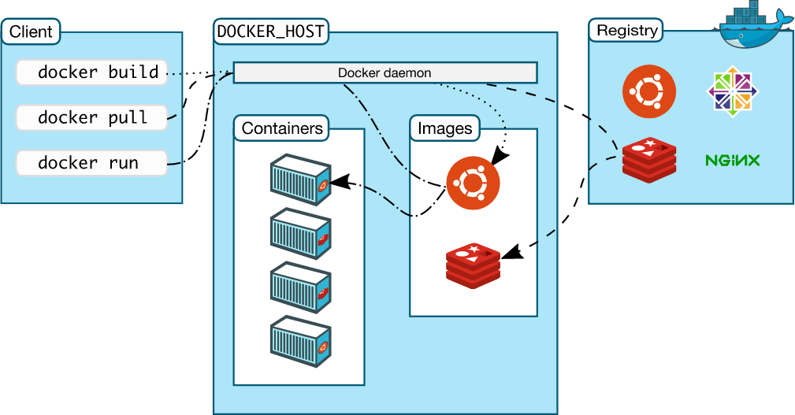
Arsitektur Docker

Slide 11
Install Docker
https://docs.docker.com/get-docker/

Slide 12
Container Registry

Slide 13
Container Registry
Docker Hub : https://hub.docker.com/
Google Container Registry : https://cloud.google.com/container-registry
Amazon Elastic Container Registry : https://aws.amazon.com/id/ecr/
Quay Container Registry : https://quay.io/
etc.

Slide 14
Docker Image

Slide 15
Container

Slide 16
Praktik
docker image docker container
docker pull nginx:latest
docker run -d -p 8181:80 --name nginx nginx:latest

Slide 17
Dockerfile
FROM golang:latest
WORKDIR /app
COPY . /app
CMD ["go", "run", "/app/main.go"]

Slide 18
Docker Build, Run
docker build -t swadharma/goapp:latest .
docker push swadharma/goapp:latest
docker pull swadharma/goapp:latest
docker run -d -p 8181:8181 -n sms swadharma/goapp:latest

Slide 19
Docker compose
Praktek...

Slide 20
Membersihkan data sampah
docker system df
docker system prune -a --volumes

Slide 21
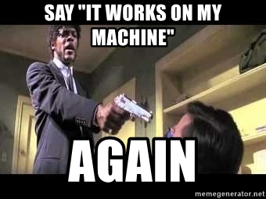

Slide 22
Next
Kubernetes

Slide 23
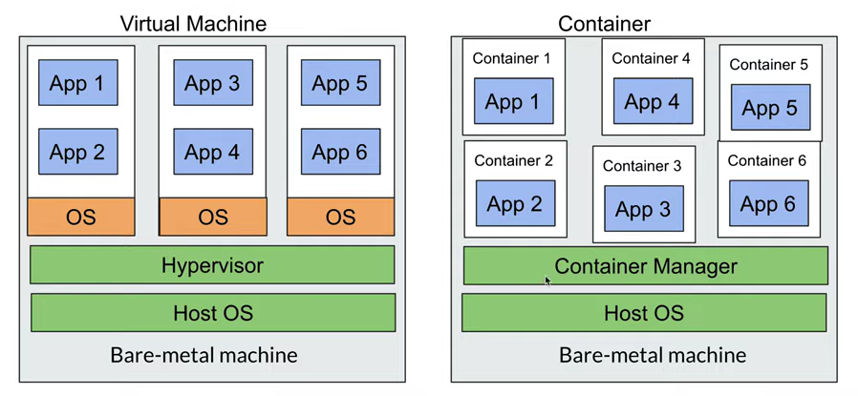
Kenapa Kubernetes
Trend microservices
Trend containerization

Slide 24
Alur Kerja Kubernetes
Kubernetes Workers / Node
Config File
2
Kubernetes Master
4

Slide 25
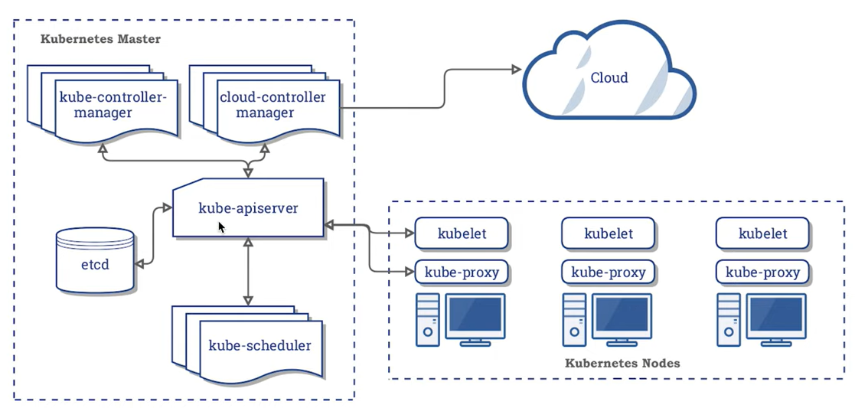
Arsitektur Kubernetes

Slide 26
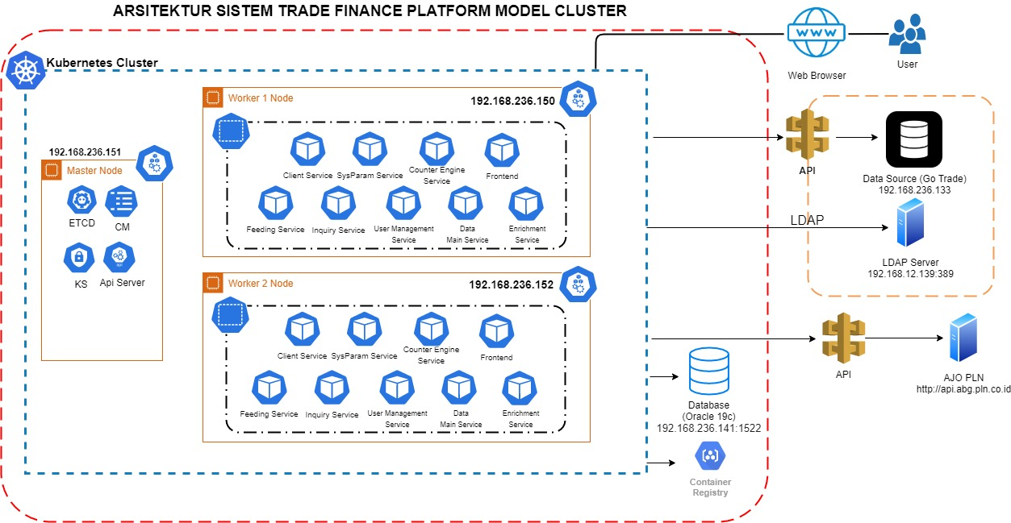

Slide 27
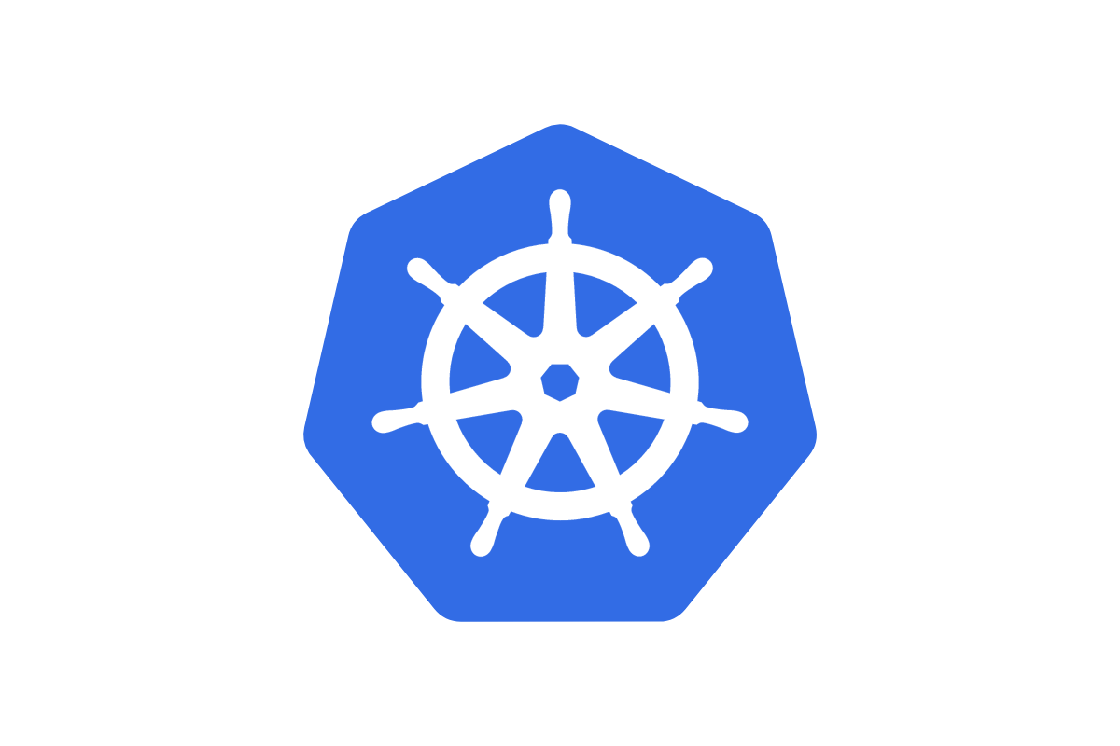

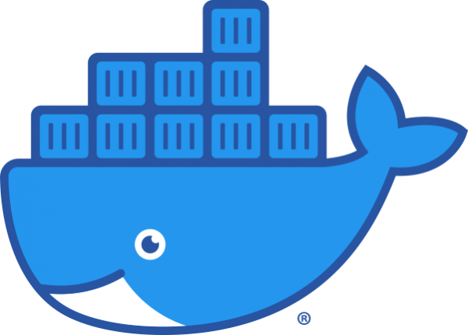
Wait, Docker is deprecated in Kubernetes now?
Is it true?
Yes, it is true. Docker is now deprecated in Kubernetes.

Slide 28
Terima kasih.
@meziaris - meziaris@gmail.com - https://mezi.space - https://mezi.web.id

